Slide 1
Community Basics:
Exploring Events

Slide 2
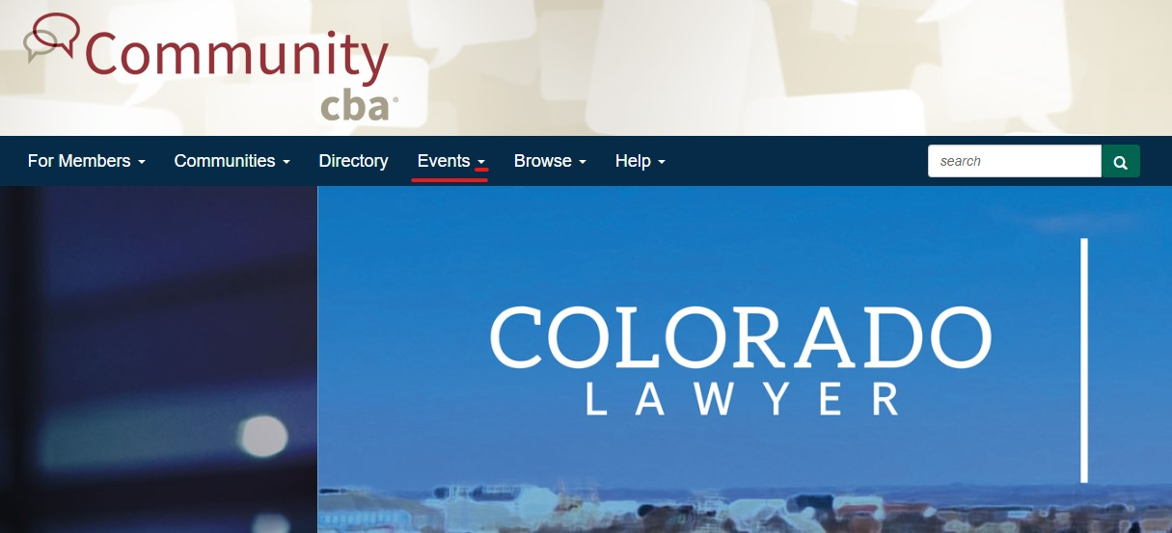
Located in the top banner, click the arrow next to ‘Events’

Slide 3
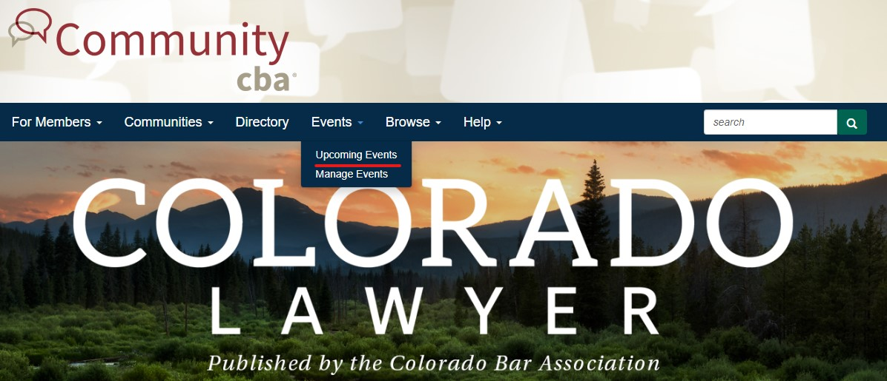
Choose ‘Upcoming Events’

Slide 4
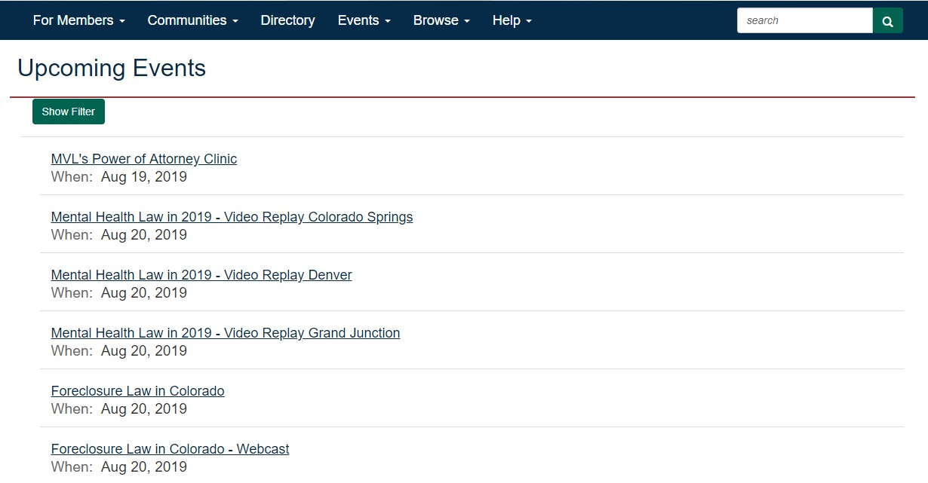

Slide 5
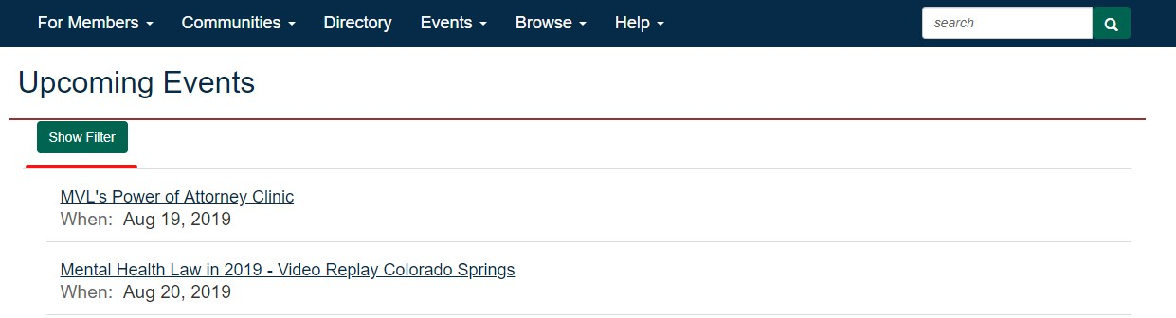
To narrow your search, click ‘Show Filter’

Slide 6
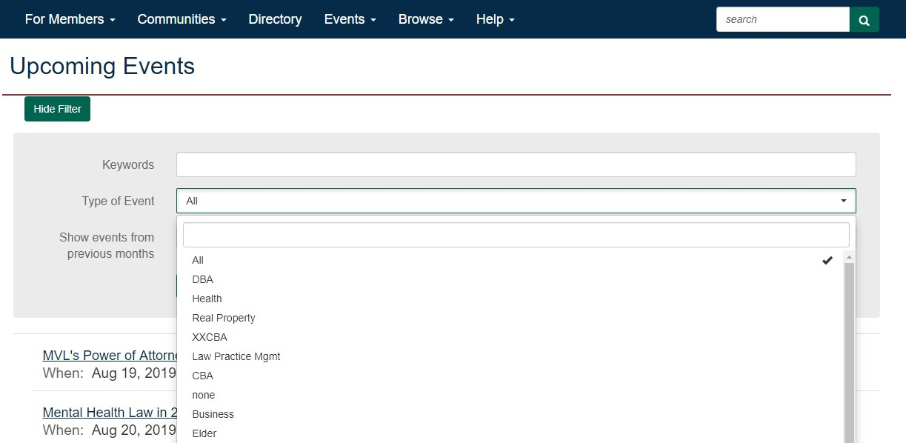
Select your desired section or add in keyword

Slide 7
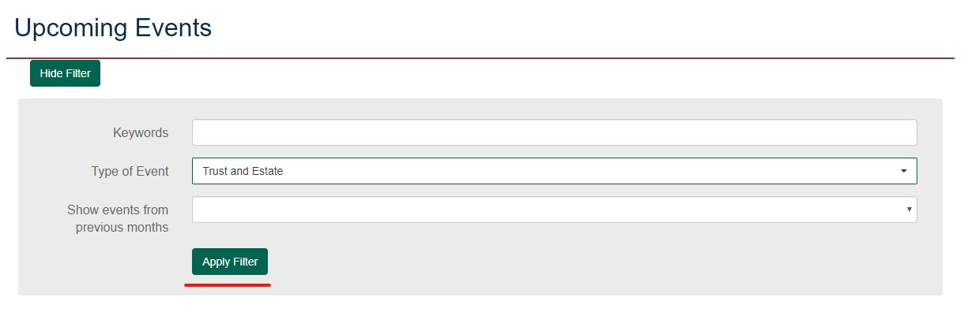
Once you have added all relevant information, click ‘Apply Filter’

Slide 8
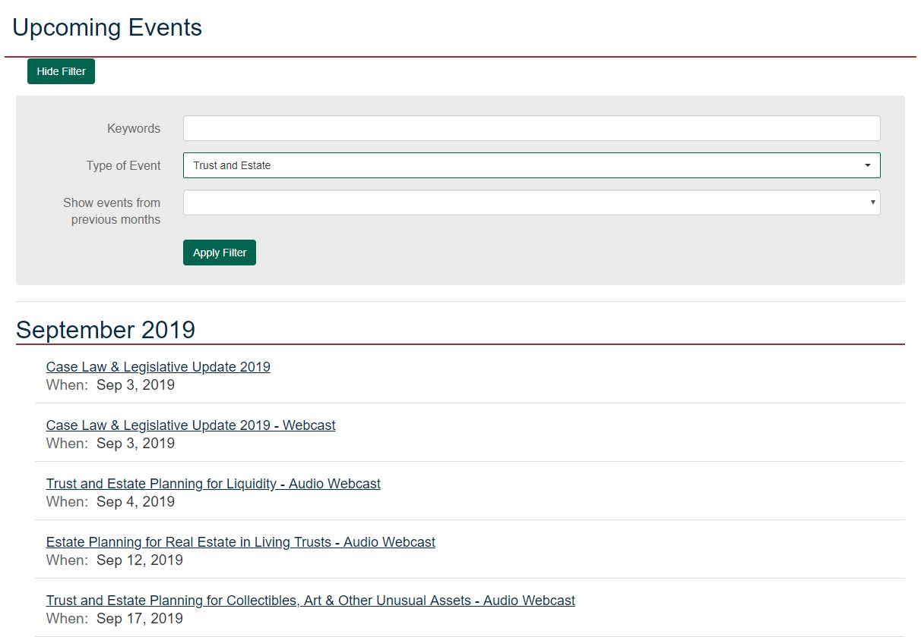
Your results will populate below the filter.

